Slide 1
Functionally Graded Materials
By :- Anand Jain (U17ME207)
Guided by Dr. Sumit Khare

Slide 2
Brief Overview :-
What is FGM? What is the need?
Classification of FGM
Processing Techniques
Gas Based Methods
Liquid Based Methods
Solid Phase Methods
4. Applications
5. Future Scope
Notes:
So the first question that comes up is that what is FGM and why is it needed? Then we’ll briefly look into the various classifications of FGM. After developing the base,we’ll cover the processing techniques used in the production of FGM and finally we’ll establish its future scope.

Slide 3
Why Functionally Graded Materials !?
Notes:
Before talking specifically abt FGM,I will brief abt the requirement of FGM

Slide 4
Alloying - a combination of metals or a metal combined with one or more other elements. Eg :- Steel (Fe + C) Alloying is done by melting the billets and casting them into desired product | Powder Metallurgy - a metal-forming process performed by sintering compacted metal powders to just below their melting points. Cost effective Complex geometry achievable Parts have lower strength and ductility Handling of metal powders is costly and hazardous
Composite Material - a material produced from two or more constituent materials with notably dissimilar chemical or physical properties Laminated Material Sandwich Material FGM | FGM - a composite that displays a continuous or a stepwise variation of material properties which results in a non-homogenous, application-oriented, microstructure composition. Can withstand very high temperatures Resolves Delamination Light weight
Notes:
The conventional process of Alloying is a combination of a metal with another element. Alloying is carried out by melting the billets and casting them into desired shapes. But the prerequisite here is that the melting temperatures of both components must be comparable. To overcome this,another method to produce a teo component system,we see Powder Metallurgy. It is a metal-forming process performed by sintering compacted metal powders to just below their melting points. This method is used quite extensively in the industry,but again,the parts produced by this method will have a lower strength and ductility.These methods are wat comes to mind when we think of a 2 component system.
Thats when we introduce ourselves with wats called as a composite material. It is a material produces from two or more constituent materials (imp.) with notably dissimilar properties. And FGM or functionally graded material is a composite material in which a contionuous or a stepwise variation of material properties is present

Slide 5
Classification of FGM
Notes:
A brief discussion on the classification of FGM

Slide 6
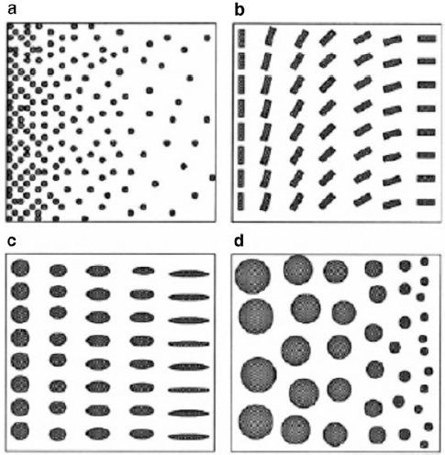
Acc. to FGM structure
Gradation of
Volume fraction
Orientation
Shape
Size
Affects Strength,Porosity,Electrical and Thermal Conductivity
2 types :-
Layerwise Graded Materials
Continuous Graded Materials
Composition Gradient
Orientation Gradient
Fraction Gradient
Notes:
According to FGM structure,the gradient could be in the form of Volume fraction,orientation of particles,shape and size of particles. The resulting FGM can either be a contionuous graded structure or a stepwise graded strucutre

Slide 7
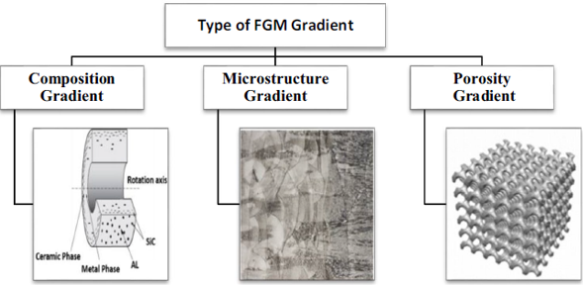
Acc. to the type of FGM Gradient
Gradation of
Volume fraction
Orientation
Shape
Size
Composition Gradient - Composition varies from one surface to other. Eg Metal Ceramic FGM
Microstructure Gradient - Cooling Rate is varied across the thickness resulting in different microstructures
Porosity Gradient - Controlled Deposition is performed to achieve porosity gradient
Notes:
Acc to the type of FGM gradient,one can create a composition gradient,ie the composition changes fo eg - in metal ceramic FGM. The microstructure of the component could vary,this is achieved by varying the cooling rate in the component such that the surface cools down,and core cools later.And then,one can vary the porosity in the component by varying the particle size and stacking

Slide 8
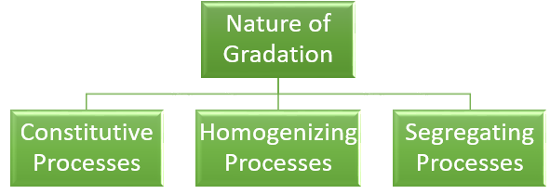
Acc. to nature of FGM gradation process
Constitutive Processes - “Layer-by-layer” construction of FGM by material deposition
Homogenizing Processes - Gradient created by material transport. Sharp interface is converted by mass transfer
Segregating Processes - Under an external electric or magnetic field, homogeneous material segregates into graded material
Advances in automation technology during the last decades have rendered constitutive gradation processes technologically and economically viable.
Notes:
Acc to the process that is used to create a gradation, one can classify them into either a constitutive process in which the component is literally constructed in 3D space,or one can create a gradation from a homogenous material by controlled segregation by either electric or magnetic fields.

Slide 9
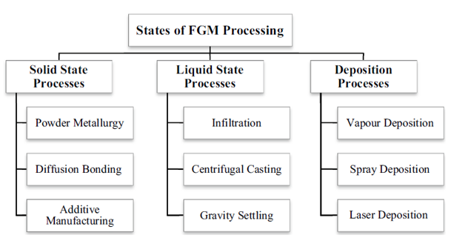
Acc. to states during FGM processing
Overall feasibility depends on time taken,finish achieved,accuracy and economic limitation among others
Deposition methods are used for close accuracy and small products.
Liquid-state processes are usually employed for large products of rather lower property control,
Solid-state-based FGMS are utilized for highly stressed thermo-mechanical components
Notes:
And finally according to the state during FGM processing. So we can construct a FGM in solid,liquid or gas phase depending on the application and then convert it into solid components. I will skip a detailed discussion here at this point as this brings us to the next unit which is FGM : Processing techniques

Slide 10
FGM : Processing Techniques

Slide 11
Outline of the Processing Route
Formation of gradation
Consolidation
(Sintering)
Functionally Graded Component
Processes that make gradation :-
Constitutive
Segregation
Homogenizing
(Discussed in detail later)
Usually drying and sintering or solidification
follows the gradation step(What is it?)
Sintering (consolidation) behavior depends on particle size and shape, composition and porosity
of the powder
Notes:
The basic outline of the steps in processing include 2 things :- a) construction of a gradation and b) Consolidation of this graded material. This consolidation is carried out by sintering. Sintering is a process of heating the component in a controlled environment below the melting point so that a bonding is created between the particles.

Slide 12
Gas Based Methods
Vapour Deposition Methods
A process through which materials are evaporated from the source and condensed at a target location and a coating is produced.
2 types :-
Physical Vapour Deposition
Chemical Vapour Deposition
2) Thermal Spray Method - A heat source is used to melt the raw materials for the coating, then by treating gases and spraying them on a base material, these molten or liquid materials are pushed until they solidify and form a solid layer.
3) Laser Deposition - Generation of a high intensity laser that strikes and converts the coating material into powder and vapor forms for deposition onto the substrate
Notes:
Coming on the gradation part,we saw 3 phases in which this can be done,First one is the Gas Based Methods. A small branching in this category,and we have a vapour deposition method in which a material is evaporated from the source and condensed at a target location forming coatings.

Slide 13
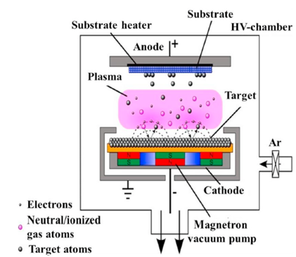
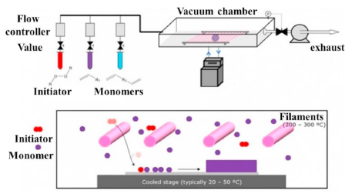
Vapour Deposition Methods
Physical Vapour Deposition
Chemical Vapour Deposition
Applications :- anti corrosion protective coating,biosensor coating
Applications :- mirror coatings, electrically conducting films corrosion protective coating
Notes:
Schematic diagrams show the setup of both Physical Vapour Deposition and Chemical Vapour Deposition Processes. In both the processes the substrate is heated by suitable means. In PVD,the vapours are formed and transported , on the substrate where it condenses through a vacuum environment under an electric field. In CVD,though,a predefined mix of reactant gases are introduced at a specified flow rate into the reaction chamber. The gas molecules move to the wafer’s surface and adhere, by adsorption. After the reactant get adsorbed on the surface, the gas molecules chemically react forming a solid that adheres to the wafer surface i.e. the reactants undergo chemical reactions with the substrate to form the film

Slide 14
Cont.
Advantages :-
Layers can be in nano/micro range .
Graded structure easy to control simply by varying the composition of the gas phase
high deposition rates and a relatively easier process control
CVD can be used to coat a multiple surfaces simultaneously
Limitations :-
Attention must be paid to subsequent heat treatments to avoid inter diffusion between the substrate and the graded film
In PVD ,deposition on complex shapes, as the surface coverage obtained is very poor.
CVD precursors can sometimes be highly toxic like Ni(CO)4 , explosive (B2H6) or corrosive (SiCl4).

Slide 15
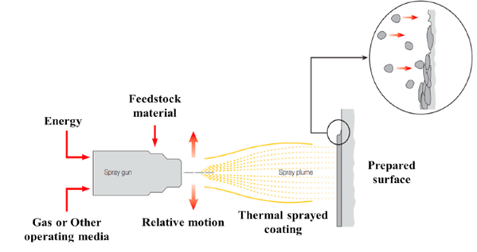
2) Thermal Spray Process
The parameters affecting the efficiency and output of the technique range from spray and heat source of the gas (as classified above),coating material parameters like precursor materials, particle size, flow behavior, shape and distribution of the melt.
Major defect in the thermal spray process is the generation of residual stresses as thermally sprayed substrate cools faster.
Notes:
Next is the thermal spray process. From the diagram we can see that a heat source is used to melt the raw materials for the coating,could be in the form of wire or powder, and with the help of high pressure gases the converted spray plume is bombarded on a base material. Spray and heat source of the gas (as classified above),coating material parameters like precursor materials, particle size, flow behavior affects the final product and its gradation

Slide 16
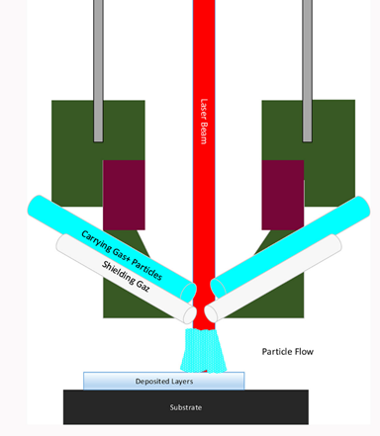
3) Laser Deposition
Generation of a high intensity laser that strikes and converts the coating material into powder and vapor forms for deposition onto the substrate.
suitable technique when there is a significant difference in melting temperature of materials
Very high accuracy process and selectively deposits the material, in turn reducing the post-process machining
It tends to be uneconomical for bulk FGM

Slide 17
Liquid Phase Methods
Commonly employed for large products of relatively lower property control
Good potential for mass production through centrifugal casting (Imp.)
Can develop graded materials with continuous properties, and vast majority of them have lower costs compared to other methods
Major drawbacks of these methods are the difficulty in controlling the gradation and wettability between materials in addition to the molten metal problems
The methods discussed are :-
Centrifugal Casting
Electrophoretic Deposition
Notes:
So that was all about the gas phase processes,next in line there are liquid phase methods which are usually employed for large products where property control may not be excellent but are economically viable enuf. The major drawback that will be realized once we look at htese methods,would be the difficulty in controlling the gradation generated.

Slide 18
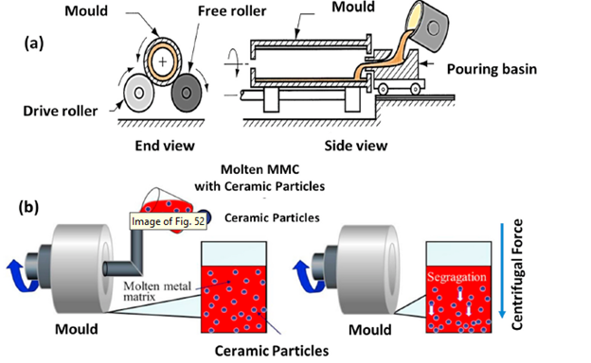
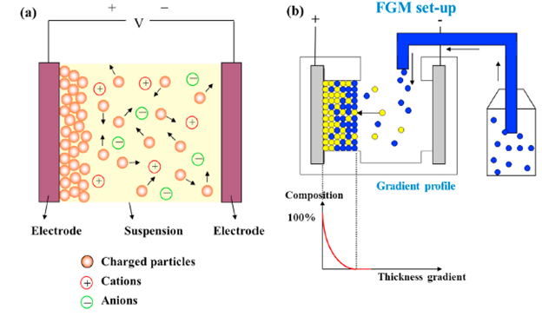
Cont.
Centrifugal Casting
2) Electrophoretic Deposition
The fundamental states that colloidal particles suspended in a liquid medium drift under the influence of an electric field (electrophoresis) and are deposited onto an electrode
short processing time, little restriction of the shape of substrate and no need for binder burnout
Principle :- segregation gradation by centrifugal force due to the density difference between two materials
Mould rotating speed influences the composition gradient in the FGM
Only cylindrical shapes can be generated
Notes:
The 2 methods we will be discussing are a) centrifugal casting and b) electrophoretic deposition. The centrifugal casting method works on the principle of segregation of particles and their movement due to the centrifugal force genrated in the rotation. So as it,is one can vary the mould rotating speed to influence the gradation but mostly thats about it. Plus as widely used as this technique is, it can used to generate cylindrical shapes only. Electrophoretic deposition on the other hand,uses the principle of elctrolysis that he particles migrate towards the chargeed electrodes and get deposited there

Slide 19
Solid Phase Methods
The most up-and-coming FGM production methods , centre of attention of researchers
Generates a discontinuous gradient though the gradation can be controlled to a high degree by incorporating these methods
2 methods discussed further are :-
Powder Metallurgy Method
Solid Freeform Fabrication Methods
Notes:
The last and the most important set of methods that is the solid phase methods are the centre of attention of researchers . Although they generate a discontionuous gradient,the gradation can be controlled to a very high degree. We will be discussing 2 methods under this heading

Slide 20
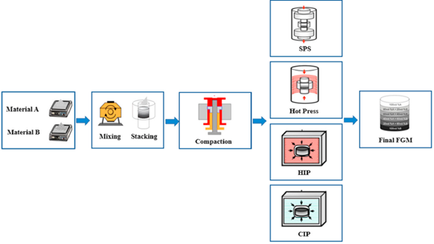
Powder Metallurgy
Powder preparation is carried out by chemical reactions, electrolytic deposition, grinding, and pulverization
Processing parameters such as temperature, time and pressure have a significant influence on properties of FGM
Enables fabrication of materials with an excellent control of chemical composition and microstructure
Production of a non-continuous structure is concerning
Undercuts and threads should be machined in following process
Economic feasibility > 100,000 products
Steps in Powder Metallurgy Process
Notes:
Powder metallurgy (PM) technique is used to produce functionally graded material through four basic steps - powder preparation, weighing and mixing of powder according to the pre-designed spatial distribution, stacking and ramming of the premixed powders (forming operations)and finally compacting and forming a solid mass of material(sintering).
The method as such can be used to produce intricate details,in the component. And since, active research has been carried out in this domain,one can influence the gradation through sintering temperature pressure of compaction,time of sintering etc.

Slide 21
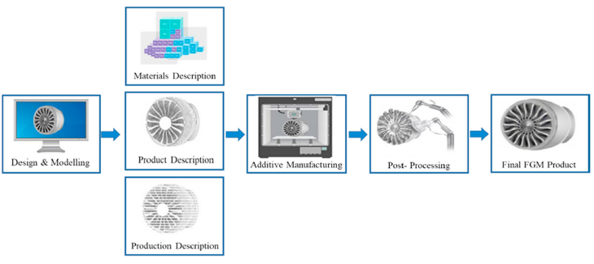
Solid Freeform Fabrication Methods
Higher speed of production
Doesn’t require explicit tooling,fixturing
Design freedom as parts are manufactured directly from CAD data
A group of techniques that manufacture a three-dimensional layered (functionally graded) component employing a computer-aided design (CAD) data. These processes fall under the controlled blending category
Notes:
A group of techniques that manufacture a three-dimensional layered (functionally graded) component employing a computer-aided design (CAD) data. These processes fall under the controlled blending category
SFF involves five basic steps :-
1. Generation of CAD data from the software like AutoCAD, Solid edge etc
2. Conversion of the CAD data to Standard Triangulation Language (STL) file
3. Slicing of the STL into two-dimensional cross-section profiles
4. Building of the component layer by layer
5. Removal and finishing.

Slide 22
Applications of FGM
Notes:
So that was all about the processing techniques,a brief overview on each catergory is covers. Next wat comes is the areas of application of FGM

Slide 23
Aerospace - rocket nozzles, space shuttles, exit cones, nose-tip of re-entry vehicle etc Eg :- A Space Shuttle utilizes FGM coating as thermal protection from heat generated during re-entry into the Earth's atmosphere. (Solves delamination) | Biomedical Applications - dental implant, knee replacement and hip joint replacement etc FGMs with the gradient structure allow the biocompatibility of the medicinal components to provide the strength of bonding and corrosion and abrasion resistance that cannot be achieved with the uniform structure
Defense Applications - armour plates and bulletproof vests,guide rods, shafts, tubes, latches, axles housings and firing pins One of the most important characteristics of functionally graded material is the ability to inhibit crack propagation making it penetration resistant. | Machinery and Equipment- cutting tools, forming moulds ,machine engine blocks,combustion chambers etc It improves the strength, thermal response, wear and corrosion resistance of these components
Notes:
These are just a very concise set of areas where FGM plays a pivotal role ,like in Aerospace eApplications,the space shuttles are coated with FGM,whch is capable of withstanding extremely high temperatures. Also,since FGM occurs widely in nature in human body in the form of teeth,skin and tissues,FGM are modeled for biomedical applications. The core stregth of the FGM is utilised in defense applications for bulletproof vests and armour plates. And given the high strength to weight ratio,various machinery equipments use FGMs

Slide 24
Conclusions
FGM has become a cornerstone of modern materials research and has the capability to revolutionize the manufacturing world if the following challenges are surmounted:-
Development of more uniform and accurate control of composition gradient in the structure
Development of low cost and high degree of automation for making the gradation
Development of large size, complex-shaped functionally graded components
Development of a process for a mass production (Solid freeform fabrication seems to be promising manufacturing method, but there are still lots of issues that need to be resolved including the cost of manufacturing, surface finish, etc.)
Notes:
FGM is an oppurtunistic area and has the capability to revolutionize the manufacturing world. I have tried to summarize the roadblocks here

Slide 25
Future Scope
As such, compared to ceramic or metal based systems the on polymer FGMs is limited. It has the potential to expand the engineering applications of polymeric materials and develop a new family of composites with tailored properties suited to bio applications.
The future recommendations for all FGMs are tended to be in five directions:
Material - Use of new materials (such as using organic reinforcement)
Process – Development of manufacturing methods by specifying the optimal parameters for production of those materials
Simulation or modelling – Development of numerical simulation or mathematical model to clarify the method of forming a graded layer or zone
Testing – To conduct a qualitative analysis of FGM and ensure the verification of numerical modelling
Mass production and development of additive manufacturing methods.

Slide 26
THANK YOU…!

